Slide 1
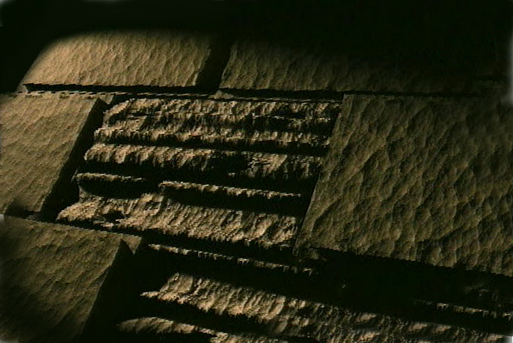
Burmese
or®musrf;pm
tkwfNrpf
Texas jrdk.rS or®musrf;pm-tkwfjrpf (edkifiHwumtrSkawmfaqmifvkyfief;) \ wifjycsuf
www.biblebasically.org
Dr ရက္ခ္ ဂရီဖိတ္၊ စကၤပူဓမၼေကာလိပ္ • BibleStudyDownloads.org

Slide 2
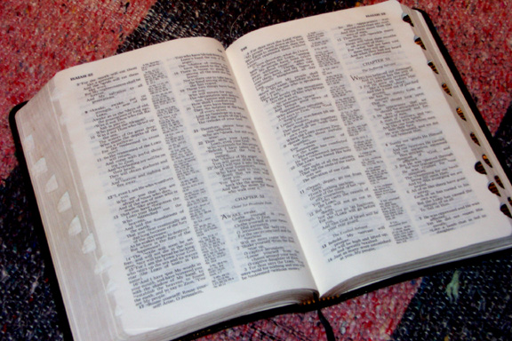
([kwfw,f 'D pmtkyf[mtpDtpOfwusa&;xm;jcif;jzpfonf?)
tajccHtm;jzifhor®musrf;pmudk
tykdif; 6 ykdif;cGJxm;onf?
®
“usrf;pmtzGifh”
©2004 TBBMI
8.0.06.
02

Slide 3
,ckcJGjcrf;pdwfjzmBunfh
&atmif
8.0.06.
©2004 TBBMI
03

Slide 4
usrf;pmtzGifh
tpdwftykdif;rsm;
aumif;pGmzGJhpnf;xm;aom - - - wkd;wufrSk&Sdaom - - - tcsdeftuefhtowfr&Sdaom - - -
A Ministry of ScriptureTechnologies International
©2004 TBBMI
8.0.06.
04
2

Slide 5
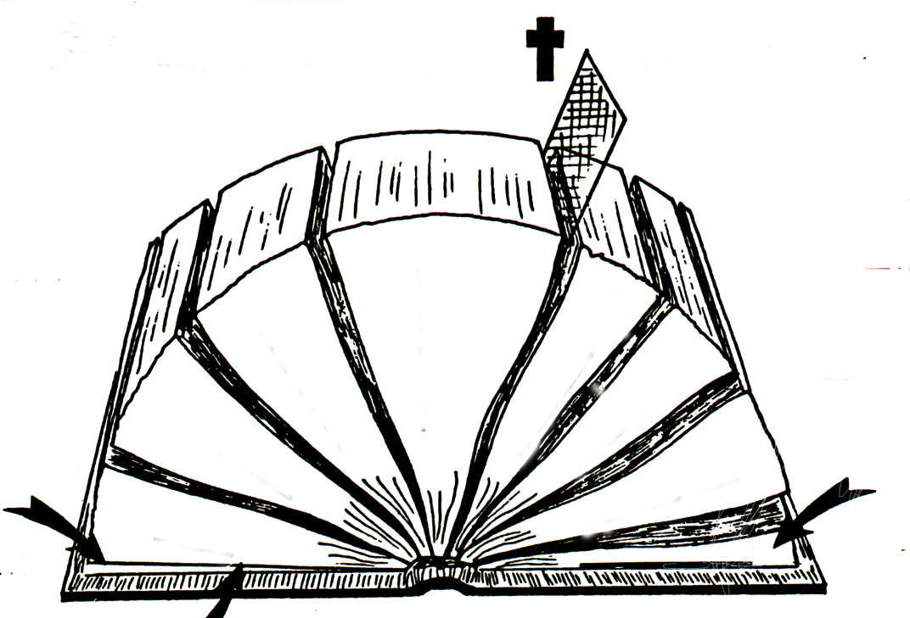
A
B
“ ”
“ ”
D(OT)
C
ONE THEME:
D(NT)
E(OT)
“ ”
E(NT)
“ ”
F(OT)
F(NT)
4
3
5
/
/
G(OT)
6
G(NT)
2
oifaxmuful trSwf -18
7
1
8
H(OT)
2
1
H(NT)
I(OT)
J
The “Opened” Bible
06-06
8.0.06.
©2004 TBBMI
05
©2004 TBBMI
06-
©TBBBI

Slide 6
yHkjyifa[mif;
yHkjyifopf
4
3
5
6
2
4
4
7
1
8
06
5

Slide 7
yHkjyifa[mif;
yHkjyifopf
4
3
5
6
2
7
1
8
07

Slide 8
yHkjyifa[mif;
yHkjyifopf
4
3
5
6
2
7
1
8
08
4

Slide 9
yHkjyifa[mif;
yHkjyifopf
owif;aumif;
4
3
5
6
2
7
1
ynwfcsuf
8
“pm&Gufpmwrf;oufaojyjcif;\tp”
09
4

Slide 10
yHkjyifa[mif;
yHkjyifopf
4
3
pmukd,fta&;tom;ü tb,ft&myg0ifovJqdk&if-
5
What follows? A body of writing!
owif;aumif;
6
wrefawmf0wÅK
2
7
ordkif;
1
ynwfcsuf
8
10
4

Slide 11
yHkjyifa[mif;
yHkjyifopf
4
3
5
owif;aumif;
uAsmqefaompmrsm;
6
2
wrefawmf0wÅK
7
orkdif;
pmapmifrsm;/ aypmrsm;
1
ynwfcsuf
8
11
3

Slide 12
yHkjyifopf
yHkjyifa[mif;
4
3
5
owif;aumif;
6
2
ya&mzufrsm;
wrefawmf0wÅK
uAsmqefaompmrsm;
7
orkdif;
pmapmifrsm;/ aypmrsm;
1
ynwfcsuf
8
Asm'dwfusrf;
12
2

Slide 13
yHkjyifopf
yHkjyifa[mif;
4
3
5
owif;aumif;
6
2
ya&mzufrsm;
wrefawmf
uAsmqefaompmrsm;
7
orkdif;
pmapmifrsm;/ aypmrsm;
1
ynwfcsuf
8
Asm'dwfusrf;
12
2

Slide 14
yHkjyifopf
yHkjyifa[mif;
4
3
5
owif;aumif;
6
2
ya&mzufrsm;
wrefawmfK
uAsmqefaompmrsm;
7
orkdif;
pmapmifrsm;/ aypmrsm;
1
ynwfcsuf
8
Asm'dwfusrf;
12
2

Slide 15
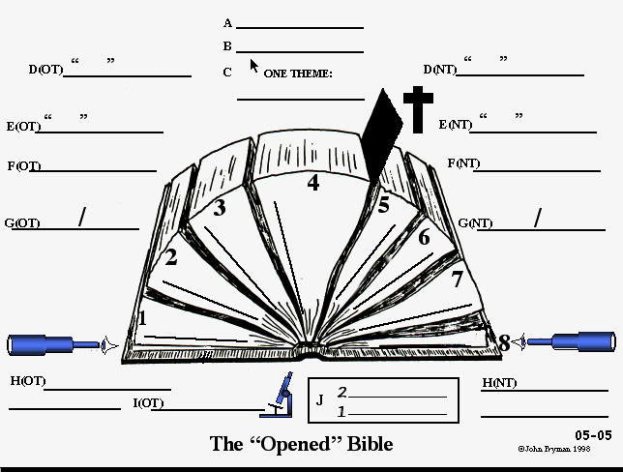
vdkif; A & B
ESpf 1600
pma&;q&mvl 40OD;
vlrsKd;pkyJ
ppfacgif;aqmifrsm;
pD;yGm;a&;orm;rsm;
uAsmq&mrsm;
4
bkef;awmfBuD;rsm;
3
5
owif;aumif;
bk&ifrsm;
6
opfckwform;rsm;
2
ya&mzuf
uAsmtvuøm
wreffawmf
&if;ESD;jrKyfESHolrsm;
7
ordkif;tjzpftysuf
a&;pmapmifrsm;
1
ynwf
8
As'dwfusrf;
14
4

Slide 16
LINE D
ESpf 1600
pma&;q&mvl 40 OD;
“yHkjyifa[mif;”
“yHkjyifopf”
aqmifykk'f
bk&m;.bkef;awmf
y#dnmOfta[mif; - - - - -y#dnmOftopf
owif;aumif;
ya&mzufrsm;
uAsmq&m
bk&m;.tvkdawmfta[mif; - - -bk&m;.tvkdawmfopf
wrefawmf
orkdif;
ynwfcsuf
Asm'dwfusrf;
16
4

Slide 17
ESpf 1600
pma&;q&mvl 40 OD;
“"r®a[mif;usrf;”
“"r®opfusrf;”
aqmifyk'f
bk&m;.bkef;awmf
LINE E
“39 usrf;”
“27 usrf;”
owif;aumif;
3 » 9 ] 27
ya&mzufrsm;
uAsmq&mrsm;
wrefawmf
orkdif;
pmapmifrsm;
ynwfcsuf
Asm'dwfusrf;
17
3

Slide 18
ESpf 1600
pma&;q&mvl 40 OD;
“"r®a[mif;usrf;”
“"r®opfusrf;”
aqmifyk'f
LINE E
bk&m;.bkef;awmf
“39 usrf;”
a[jAJbmom
“27 usrf;”
*&dbmom
owif;aumif;
ya&mzufrsm;
uAsmq&mrsm;
wrefawmf
orkdif;
pmapmifrsm;
ynwfcsuf
Asm'dwfusrf;
17
3

Slide 19
ESpf 1600
pma&;q&mvlOD;a& 40
yHkjyifa[mif;
yHkjyifopf
bk&m;.bkef;awmf
aqmifyk'f -
39 usrf;
27 usrf;
LINE GG
Hebrew
*&d
owif; aumif;
ynwf/ uwdawmf
ya&mzufrsm;
aus;Zl;awmfjynfhpHkjcif;
uAsmq&m
wref
orkdif;
aypmrsm;
ynwf
As'dwfusrf;
19
6

Slide 20
ESpf 1600
pma&;q&mvl 40 OD;
yHkjyifa[mif;
yHkjyifopf
aqmifyk'f -
bk&m;.bkef;awmf
39 usrf;
27 usrf;
a[jAJ
*&d
owif;aumif;
ynwf
LINE H
ya&mzufrsm;
Promise
wref
aus;Zl;awmfjynfhpHkjcif;
uAsmq&m
orkdif;
ay;pmrsm;
ynwf
Asm'dwfusrf;
20

Slide 21
ESpf 1600
pma&;q&mvl 40 OD;
yHkjyifopf
yHkjyifa[mif;
aqmifyk'f -
bk&m;.bkef;awmf
39 usrf;
27 usrf;
a[jAJ
*&d
ynwfuwdawmf
ya&mzufrsm;
owif;aumif;
Promise
uAsmq&m
aus;Zl;awmfjynfhpHkjcif;
LINE H
wref
orkdif;
xm0&vGefcJhaomta0;BunfhrSefajymif;
ay;pmrsm;
xm0&tem*wft a0;BunfhrSefajymif;
ynwf
Asm'dwfusrf;
21
3

Slide 22
ESpf 1600
pma&;q&mvl 40 OD;
yHkjyifa[mif;
aqmifyk'f -
bk&m;.bkef;awmf
yHkjyifopf
39 usrf;
27 usrf;
a[jAJ
*&d
tmjA[H
ynwfuwdawmf
aus;Zl;awmfjynfhpHkjcif;
ya&mzufrsm;
uAsmq&m
urÇm 12 - -- -
Telescope
orkdif;
ynwf
Eternity Past
ta0;=unfhrSefajymif;
LINE I
22
5

Slide 23
ESpf 1600
pma&;q&mvl 40 OD;
yHkjyifa[mif;
yHkjyifopf
aqmifyk'f -
bk&m;.bkef;awmf
27 usrf;
39 usrf;
a[jAJ
*&d
ynwfuwdawmf
ya&mzufrsm;
owif;aumif;
aus;Zl;awmfjynfhpHkjcif;
uAsmq&m
wref
xm0&vGefcJhaomta0;BunfhrSef ajymif;
xm0&tem*wfta0;BunfhrSef ajymif;
orkdif;
aypmrsm;
ynwf
Asm'dwfusrf;
LINE J
2/ ta0;BunfhrSefajymif; 1/ ta0;BunfhrSefajymif;
23

Slide 24
ESpf 1600
pma&;q&mvl 40 OD;
yHkjyifa[mif;
aqmifyk'f -
bk&m;.bkef;awmf
yHkjyifopf
39 usrf;
27 usrf;
a[jAJ
*&d
ynwfuwdawmf
ya&mzufrsm;
owif;aumif;
aus;Zl;awmfjynfhpHkjcif;
uAsmq&m
wref
xm0&vGefcJhaomta0;BunfhrSef ajymif;
xm0&tem*wfta0;BunfhrSefajymif;
orkdif;
aypmrsm;
ynwf
Asm'dwfusrf;
t%ao;BunfhrSef ajymif;
2/ ta0;BunfhrSefajymif; 1/ BunfhrSefajymif;
24
1

Slide 25
1600 years
KADESH BARNEA
1600 years
The CALL
1600 years
KADESH BARNEA
The CALL
S - D - S
S - D - S
40 authors
40 authors
“OLD”
Testament
40 authors
“OLD”
Testament
“NEW”
Testament
“OLD”
Testament
“NEW”
Testament
40
“NEW”
Testament
GOSPELS
40
GOSPELS
ONE THEME:
ONE THEME:
ONE THEME:
EPISTLES
SINAI
EPISTLES
SINAI
the glory of God
the glory of God
the glory of God
“c&pfawmf\omoem”
JERICHO
JERICHO
LAND DIVIDED
LAND DIVIDED
“39” Books
“27” Books
“39” Books
“27” Books
“39” Books
“27” Books
430
430
EXODUS
CHURCH
EXODUS
CHURCH
70 YEARS
70 YEARS
Hebrew
Greek
Hebrew
Greek
Hebrew
Greek
PROPHETS
ISRAEL
PROPHETS
ISRAEL
GOSPELS
GOSPELS
J - E
GOSPELS
J - E
Grace/
Law/
Grace/
Law/
Grace/
Law/
SLAVERY
ACTS
SLAVERY
ACTS
PROPHECIES
Promise
PROPHECIES
Fulfillment
Promise
Fulfillment
Promise
PROPHECIES
Fulfillment
ACTS
ACTS
WRITINGS
ACTS
WRITINGS
JUDGES
WRITINGS
JUDAH
JUDGES
JUDAH
350
350
L - S - B
HISTORIES
L - S - B
HISTORIES
Telescope
HISTORIES
EPISTLES
Telescope
EPISTLES
Telescope
Telescope
EPISTLES
Telescope
I - I
Telescope
I - I
REVELATION
LAW
12 TRIBES
REVELATION
LAW
12 TRIBES
LAW
REVELATION
REVELATION
REVELATION
Eternity Past
Eternity Future
Eternity Past
Eternity Future
Eternity Past
Eternity Future
M - C - C
Z - E - N
M - C - C
Z - E - N
2 Telescopes
1 Microscope
2 Telescopes
1 Microscope
2 Telescopes
1 Microscope
Microscope
Microscope
Microscope
5 SERMONS
5 SERMONS
3 TREKS...
3 TREKS...
06-27
06-27
8.0.06.
©2004 TBBMI
25

Slide 26
1600 years
1600 years
1600 years
KADESH BARNEA
The CALL
KADESH BARNEA
The CALL
"r®a[mif;ESifh"r®opfusrf;udkpDpOfwusjzpfajrmufap&ef,SOfwGJazmfjycsufrsm;
owif;aumif;/ ordkif;rsm;ESifhwrefawmfrsm;,Ofaus;rSlwkd;wufqkdif&mrsm;ukdjyaom
ta&;tom;.pmudk,fudkjzpfay:apaom - - -
uAsmESifhay;pmrsm;'Dtykdif; 2 ykdif;udkcsefxm;vQifor®musrf;pm\xl;jcm;rIjzpfonf?
S - D - S
S - D - S
40 authors
40 authors
40 authors
“OLD”
Testament
“NEW”
Testament
“OLD”
Testament
“OLD”
Testament
“NEW”
Testament
“NEW”
Testament
40
GOSPELS
40
GOSPELS
ONE THEME:
ONE THEME:
ONE THEME:
EPISTLES
SINAI
EPISTLES
SINAI
the glory of God
the glory of God
the glory of God
JERICHO
JERICHO
LAND DIVIDED
LAND DIVIDED
“39” Books
“27” Books
“27” Books
“39” Books
“27” Books
“39” Books
430
430
EXODUS
CHURCH
EXODUS
CHURCH
70 YEARS
70 YEARS
Hebrew
Greek
Hebrew
Hebrew
Greek
Greek
PROPHETS
ISRAEL
PROPHETS
ISRAEL
GOSPELS
GOSPELS
J - E
GOSPELS
J - E
Grace/
Law/
Grace/
Law/
Grace/
Law/
SLAVERY
ACTS
SLAVERY
ACTS
PROPHECIES
Promise
PROPHECIES
Fulfillment
Promise
Promise
Fulfillment
PROPHECIES
Fulfillment
ACTS
ACTS
WRITINGS
ACTS
WRITINGS
WRITINGS
JUDAH
JUDGES
JUDAH
JUDGES
350
350
L - S - B
HISTORIES
L - S - B
HISTORIES
Telescope
HISTORIES
EPISTLES
Telescope
Telescope
EPISTLES
Telescope
EPISTLES
Telescope
I - I
Telescope
I - I
LAW
12 TRIBES
LAW
12 TRIBES
REVELATION
LAW
REVELATION
STUDY HELP #18
REVELATION
REVELATION
REVELATION
Eternity Past
Eternity Future
Eternity Past
Eternity Past
Eternity Future
Eternity Future
M - C - C
M - C - C
Z - E - N
Z - E - N
ya&mzufESifhoufqdkif aomAsm'dwfawmf
2 Telescopes
1 Microscope
2 Telescopes
1 Microscope
2 Telescopes
1 Microscope
Microscope
Microscope
Microscope
5 SERMONS
5 SERMONS
3 TREKS...
3 TREKS...
06-27
06-27
06-27
8.0.06.
5
©2004 TBBMI
26

Slide 27
ESpf 1600
pma&;q&mvl 40 OD;
yHkjyifa[mif;
aqmifyk'f -
bk&m;.bkef;awmf
yHkjyifopf
39 usrf;
27 usrf;
a[jAJ
*&d
ynwfuwdawmf
ya&mzufrsm;
owif;aumif;
aus;Zl;awmfjynfhpHkjcif;
uAsmq&m
wref
xm0&vGefcJhaomta0;BunfhrSef ajymif;
xm0&tem*wfta0;BunfhrSef ajymif;
orkdif;
aypmrsm;
ynwf
Asm'dwfusrf;
t%eD;BunfhrSef ajymif;
2/ ta0;unfhrSefajymif; 1/ t%eD;BunfhrSefajymif;
24
1

Slide 28
ESpf 1600
pma&;q&mvl 40 OD;
yHkjyifa[mif;
aqmifyk'f -
bk&m;.bkef;awmf
yHkjyifopf
39 usrf;
27 usrf;
a[jAJ
*&d
ynwfuwdawmf
ya&mzufrsm;
aus;Zl;awmfjynfhpHkjcif;
owif;auif;
uAsmq&m
wref
xm0&vGefcJhaomta0;BunfhrSef ajymif;
xm0&tem*wfta0;BunfhrSef ajymif;
orkdif;
aypmrsm;
ynwf
Asm'dwfusrf;
teD;BunfhrSef ajymif;
2/ ta0;BunfhrSefajymif; 1/ teD;BunfhrSefajymif;
24
1

Slide 29
ESpf 1600
pma&;q&mvl 40 OD;
yHkjyifa[mif;
aqmifyk'f -
bk&m;.bkef;awmf
yHkjyifopf
27 usrf;
39 usrf;
a[jAJ
*&d
ynwfuwdawmf
ya&mzufrsm;
owif;aumif;
aus;Zl;awmfjynfhpHkjcif;
uAsmq&m
wref
xm0&vGefcJhaomta0;BunfhrSef ajymif;
xm0&tem*wfta0;BunfhrSef ajymif;
orkdif;
aypmrsm;
ynwf
Asm'dwfusrf;
teD;BunfhrSef ajymif;
2/ ta0;BunfhrSefajymif; 1/ teD;BunfhrSefajymif;
24
1

Slide 30
ESpf 1600
pma&;q&mvl 40 OD;
yHkjyifa[mif;
aqmifyk'f -
bk&m;.bkef;awmf
yHkjyifopf
39 usrf;
27 usrf;
a[jAJ
*&d
ynwfuwdawmf
ya&mzufrsm;
owif;aumif;
aus;Zl;awmfjynfhpHkjcif;
uAsmq&m
wref
xm0&vGefcJhaomta0;BunfhrSef ajymif;
xm0&tem*wfta0;BunfhrSefajymif;
orkdif;
aypmrsm;
ynwf
Asm'dwfusrf;
t%eD;BunfhrSef ajymif;
2/ ta0;BunfhrSefajymif; 1/ t%eD;BunfhrSefajymif;
24
1

Slide 31
ESpf 1600
pma&;q&mvl 40 OD;
yHkjyifa[mif;
aqmifyk'f -
bk&m;.bkef;awmf
yHkjyifopf
39 usrf;
27 usrf;
a[jAJ
*&d
ynwfuwdawmf
ya&mzufrsm;
owif;aumif;
aus;Zl;awmfjynfhpHkjcif;
uAsmq&m
wref
xm0&vGefcJhaomta0;BunfhrSef ajymif;
xm0&tem*w fta0;BunfhrSefajymif;
orkdif;
aypmrsm;
ynwf
Asm'dwfusrf;
teD;BunfhrSef ajymif;
2/ ta0;BunfhrSefajymif; 1/ teD;BunfhrSefajymif;
24
1

Slide 32
ESpf 1600
pma&;q&mvl 40 OD;
yHkjyifa[mif;
aqmifyk'f -
bk&m;.bkef;awmf
yHkjyifopf
39 usrf;
27 usrf;
a[jAJ
*&d
ynwfuwdawmf
ya&mzufrsm;
owif;aumif;
aus;Zl;awmfjynfhpHkjcif;
uAsmq&m
wref
xm0&vGefcJhaomta0;BunfhrSe fajymif;
xm0&tem*wfta0;BunfhrSef ajymif;
orkdif;
aypmrsm;
ynwf
Asm'dwfusrf;
teD;BunfhrSef ajymif;
2/ ta0;BunfhrSefajymif; 1/ teD;BunfhrSefajymif;
24
1

Slide 33
ESpf 1600
pma&;q&mvl 40 OD;
yHkjyifa[mif;
aqmifyk'f -
bk&m;.bkef;awmf
yHkjyifopf
39 usrf;
27 usrf;
a[jAJ
*&d
ynwfuwdawmf
ya&mzufrsm;
owif;aumif;
aus;Zl;awmfjynfhpHkjcif;
uAsmq&m
wref
xm0&vGefcJhaomta0;BunfhrSe fajymif;
xm0&tem*wfta0;BunfhrSef ajymif;
orkdif;
aypmrsm;
ynwf
Asm'dwfusrf;
teD;BunfhrSef ajymif;
2/ ta0;BunfhrSefajymif; 1/ teD;BunfhrSefajymif;
24
1

Slide 34
ESpf 1600
pma&;q&mvl 40 OD;
yHkjyifa[mif;
aqmifyk'f -
bk&m;.bkef;awmf
yHkjyifopf
39 usrf;
27 usrf;
a[jAJ
*&d
ynwfuwdawmf
ya&mzufrsm;
owif;aumif;
aus;Zl;awmfjynfhpHkjcif;
uAsmq&m
wref
xm0&vGefcJhaomta0;BunfhrSef ajymif;
xm0&tem*wfta0;BunfhrSef ajymif;
orkdif;
aypmrsm;
ynwf
Asm'dwfusrf;
teD;BunfhrSef ajymif;
2/ ta0;BunfhrSefajymif; 1/ teD;BunfhrSefajymif;
24
1

Slide 35
ESpf 1600
pma&;q&mvl 40 OD;
yHkjyifa[mif;
aqmifyk'f -
bk&m;.bkef;awmf
yHkjyifopf
39 usrf;
27 usrf;
a[jAJ
*&d
ynwfuwdawmf
ya&mzufrsm;
owif;aumif;
aus;Zl;awmfjynfhpHkjcif;
uAsmq&m
wref
xm0&vGefcJhaomta0;BunfhrSef ajymif;
xm0&tem*wfta0;BunfhrSef ajymif;
orkdif;
aypmrsm;
ynwf
Asm'dwfusrf;
teD;BunfhrSef ajymif;
2/ ta0;BunfhrSefajymif; 1/ teD;BunfhrSefajymif;
24
1

Slide 36
ESpf 1600
pma&;q&mvl 40 OD;
yHkjyifa[mif;
aqmifyk'f -
bk&m;.bkef;awmf
yHkjyifopf
39 usrf;
27 usrf;
a[jAJ
*&d
ynwfuwdawmf
ya&mzufrsm;
owif;aumif;
aus;Zl;awmfjynfhpHkjcif;
uAsmq&m
wref
xm0&vGefcJhaomta0;BunfhrSef ajymif;
xm0&tem*wfta0;unfhrSef ajymif;
orkdif;
aypmrsm;
ynwf
Asm'dwfusrf;
teD;BunfhrSef ajymif;
2/ ta0;BunfhrSefajymif; 1/ teD;BunfhrSefajymif;
24
1

Slide 37
ESpf 1600
pma&;q&mvl 40 OD;
yHkjyifa[mif;
aqmifyk'f -
bk&m;.bkef;awmf
yHkjyifopf
39 usrf;
27 usrf;
a[jAJ
*&d
ynwfuwdawmf
ya&mzufrsm;
owif;aumif;
aus;Zl;awmfjynfhpHkjcif;
uAsmq&m
wref
xm0&vGefcJhaomta0;BunfhrSef ajymif;
xm0&tem*wfta0;BunfhrSef ajymif;
orkdif;
aypmrsm;
ynwf
Asm'dwfusrf;
teD;BunfhrSef ajymif;
2/ ta0;BunfhrSefajymif; 1/ teD;BunfhrSefajymif;
24
1

Slide 38
ESpf 1600
pma&;q&mvl 40 OD;
yHkjyifa[mif;
aqmifyk'f -
bk&m;.bkef;awmf
yHkjyifopf
39 usrf;
27 usrf;
a[jAJ
*&d
tmjA[H
ynwfuwdawmf
aus;Zl;awmfjynfhpHkjcif;
ya&mzufrsm;
uAsmq&m
urÇm 12 -
orkdif;
Telescope
ynwf
Eternity Past
LINE I
ta0;BunfhrSefajymif;
22
5

Slide 39
tykdif;tprsm;
or®musrf;pmcGJjcrf;pdwfjzmjcif;
tykdif;tprsm;
aumif;pGmzJGYpnf;xm;aom - - - wkd;wufrSk&Sdaom - - - tcsdeftuefYtowfr&Sdaom
A Ministry of ScriptureTechnologies International
©2004 TBBMI
8.0.06.
38

Slide 40
or®musrf;pmcGJjcrf;pdwfjzmjcif;
tykdif;tprsm;
aumif;pGmzJGYpnf;xm;aom - - - wkd;wufrSk&Sdaom - - - tcsdeftuefYtowfr&Sdaom
A Ministry of ScriptureTechnologies International
©2004 TBBMI
8.0.06.
39

Slide 41
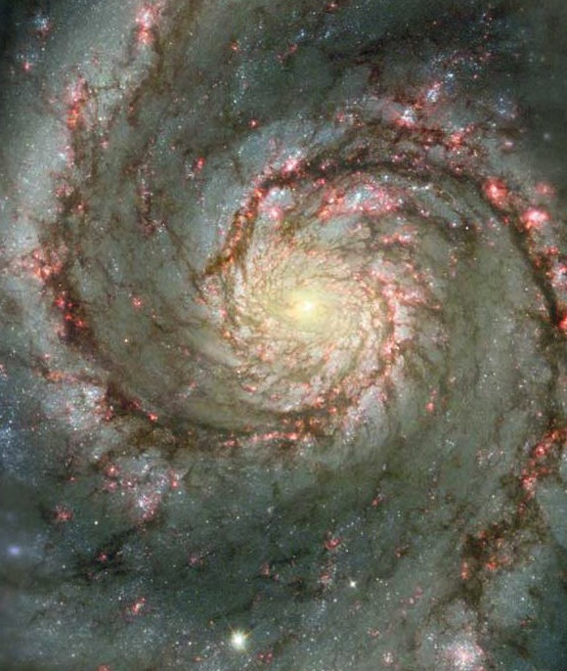
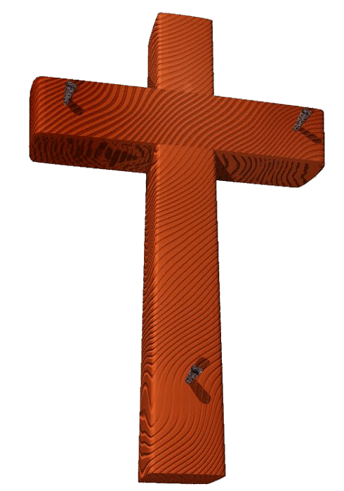
bk&m;ocif\bkef;awmf
1
06-31
40
©2004 TBBMI
8.0.06.

Slide 42
Burmese
or®musrf;pm
tkwfNrpf
Texas jrdk.rS or®musrf;pm-tkwfjrpf (edkifiHwumtrSkawmfaqmifvkyfief;)\ wifjycsuf
www.biblebasically.com

Slide 43
တရားေဟာျခင္းအ တတ္ပညာ • BibleStudyDownloads.org
အခမဲ့အဘို့ဤတင်ပြချက်
Notes:
Preaching (pr)
Homiletics

Slide 44
Black

